Slide 1

Sreyas Institute of Engineering and Technology
An Autonomous Institution
Approved by AICTE, Affiliated to JNTUH
Accredited by NAAC-A Grade, NBA (CSE, ECE & ME) & ISO 9001:2015 Certified
Department of Computer Science and Engineering
A REAL-TIME PROJECT REVIEW-2
On
Smart Queue and Appointment Management System
BACHELOR OF TECHNOLOGY
IN
COMPUTER SCIENCE AND ENGINEERING
BY
24VE1A05A9 SHREE PRANAV
24VE1A05A2 Kaveri Podisheti
24VE1A0569 B. Anjali Devi
24VE1A0575 CH. Chandu
Under the Guidance of -
Dr .G J BHARAT KUMAR

Slide 2
List of modules
-User Module: Allows users to register and log in to the system. Users can book, cancel, or reschedule appointments, view real-time queue status, and check estimated waiting time, reducing the need to wait physically.
-Admin Module: Used by administrators to manage the entire system. Admins monitor queues, manage appointments, add or update services, and generate system reports to ensure smooth operation.
-Appointment Management Module: Handles scheduling-related tasks such as booking appointments, modifying or canceling them, checking service availability, and maintaining appointment status.

Slide 3
List of modules
-Queue Management Module: Manages queue tokens and service flow. It generates token numbers, updates queue progress, calculates waiting time, and displays real-time queue information to users.
-Database Module: Stores all system data securely using a cloud-based MySQL database. It manages user records, appointment details, queue data, and ensures data consistency and security.
-Notification & Reporting Module: Sends appointment confirmations, token updates, and delay notifications to users. It also generates reports and analytics for administrators to analyze system performance.

Slide 4
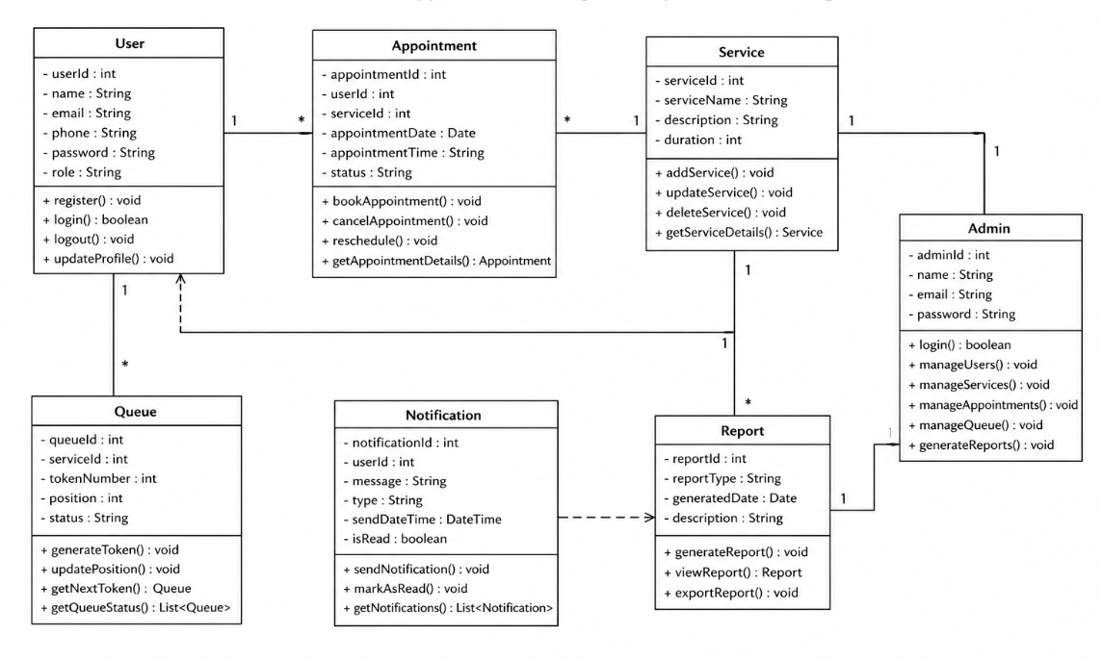
Class diagram

Slide 5
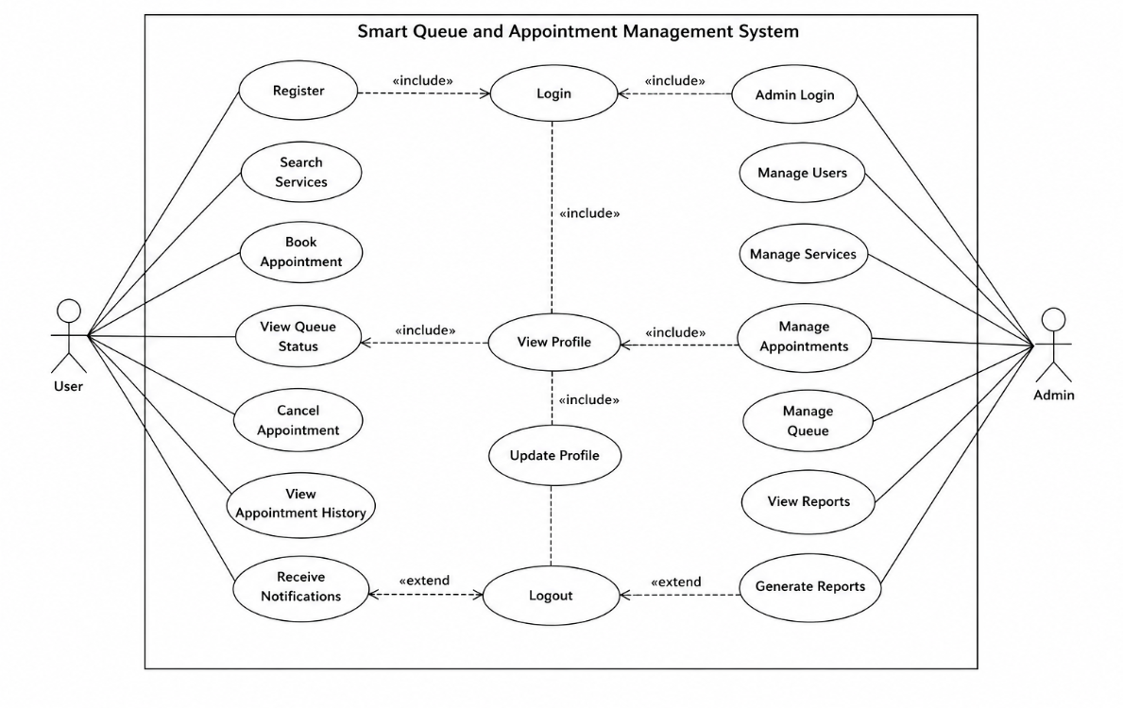
Use case diagram

Slide 6
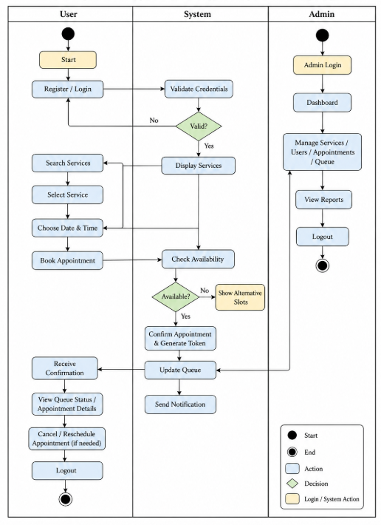
Activity diagram

